Slide 1
Introduction to SOA and Microservices Security
Oxford University
Software Engineering Programme
April 2021

Slide 2
Security Aims
Confidentiality
Integrity
Availability
Authenticity
Non-Repudiation
Authorization

Slide 3
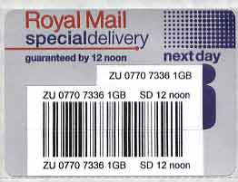
In Real Life
The opacity of the envelope provides confidentiality
The seal on the envelope provides integrity
Royal Mail hopefully provides availability
The signature provides authenticity
The proof of posting and “signed-for” provide non-repudiation
None of these match up to the standards of electronic security

Slide 4
Confidentiality
Provided by Encryption
On the web, 99% of the time using TLS
TLS is the successor to SSL
And often referred to as SSL!
If you want to understand TLS well, this is about the best resource I’ve seen:
http://www.moserware.com/2009/06/first-few-milliseconds-of-https.html

Slide 5
Encryption is pointless without authenticity/identity
If I encrypt the message aimed at the wrong person, I have failed
Encryption key distribution was the biggest issue until
1973: Ellis, Cocks and Williamson of GCHQ created first “non-secret crypto”
Only made public in 1997
1976: Diffie Helman key exchange
1977: Rivest Shamir Adleman (RSA) public key cryptography

Slide 6
A simple analogy
Padlocks which cannot be explored, re-engineered or re-used
Keys which cannot be reverse-engineered into a padlock

Slide 7
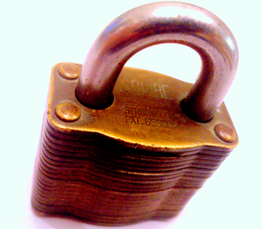
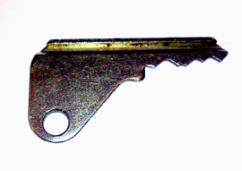
Public Key Encryption
You send out as many padlocks as you like, but you keep the key secret
2. I lock the message in a box with YOUR padlock and send it to you
3. Only you have the key, so only you can read the message

Slide 8
Authenticity
Need to Sign the message
Now I send out lots of keys but keep the padlocks secret
Anything I lock up in a box with my padlock must come from me
Anyone can unlock it and verify its from me

Slide 9
Hash functions
Take a message and create a fixed size result
E.g. 256 bits of data
The aim of a hash function is to have no duplicate hits, and a random distribution of responses
The only way to find the input from the output is a dictionary attack

Slide 10
Signatures
Actually the encrypted hash using the private key to encrypt
The validator decrypts the message
Applies the same hash function
Compares the two

Slide 11
Certificate Authority
Instead of everybody needing to know about each other’s keys, you have a trust hierarchy:
I create a key pair (key + padlock)
Export the public key (key)
Prove who I am to the CA
The CA “signs” the key
Locks my key in their padlock
Anyone who opens it knows that it is verified by them

Slide 12
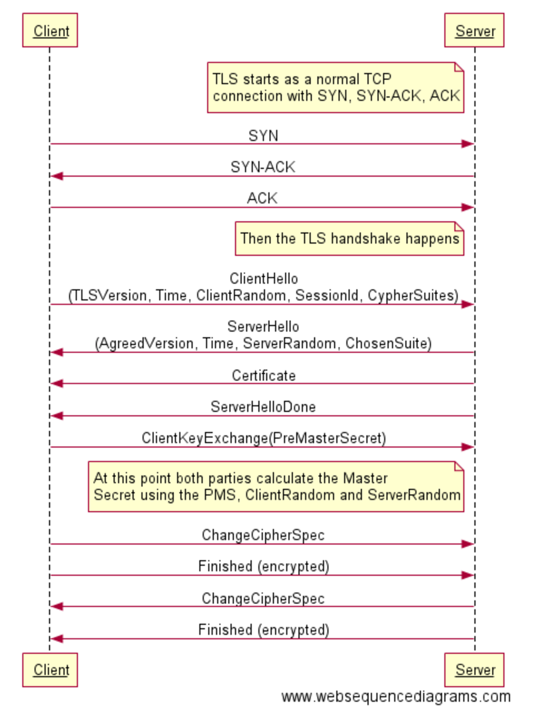
Transport
Layer
Security
(TLS)

Slide 13
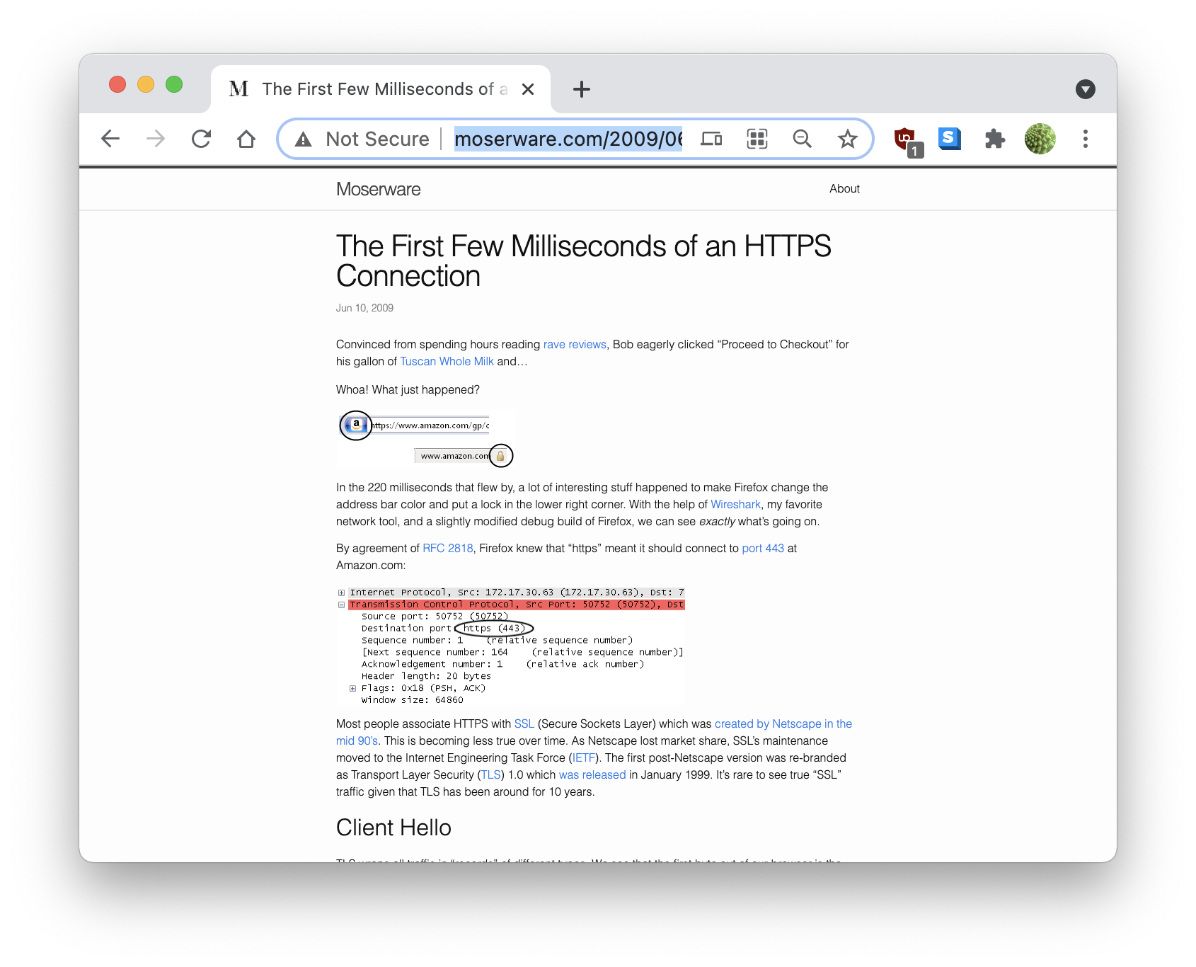
More details
http://www.moserware.com/2009/06/first-few-milliseconds-of-https.html
https://tlseminar.github.io/first-few-milliseconds

Slide 14
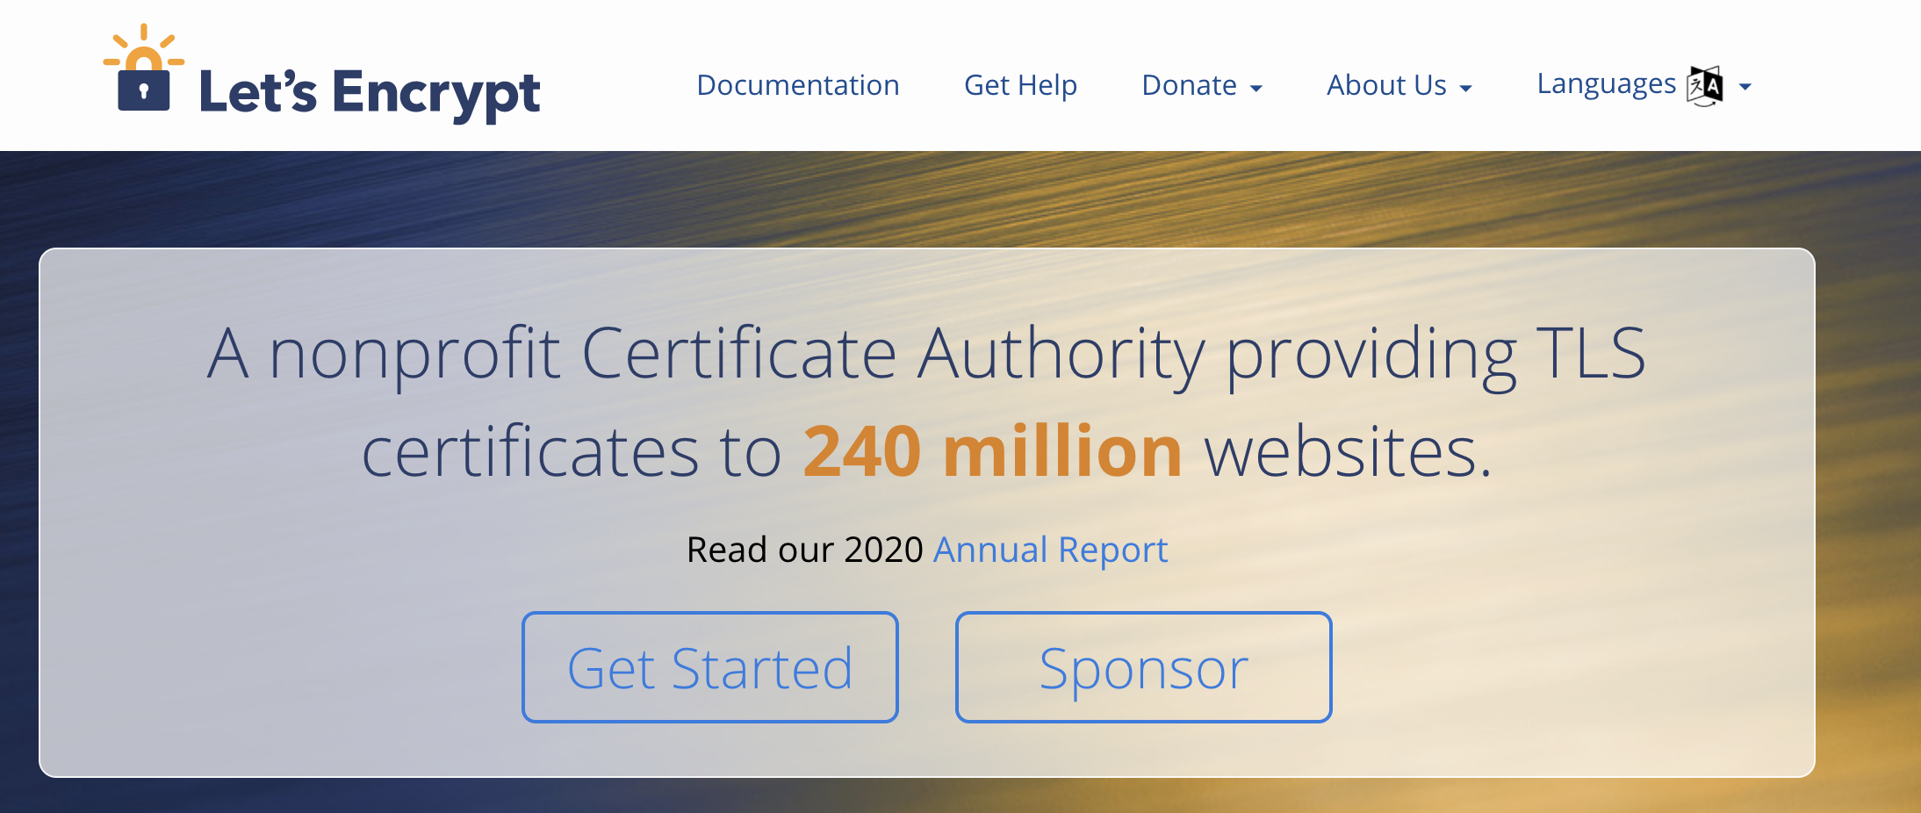
LetsEncrypt

Slide 15
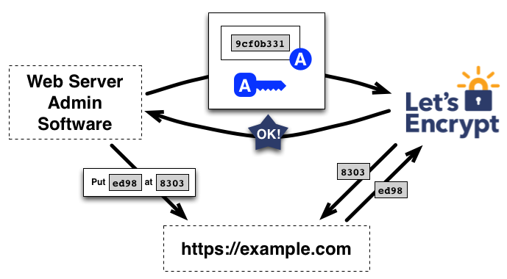
Automatic Certificate Management Environment (ACME)

Slide 16
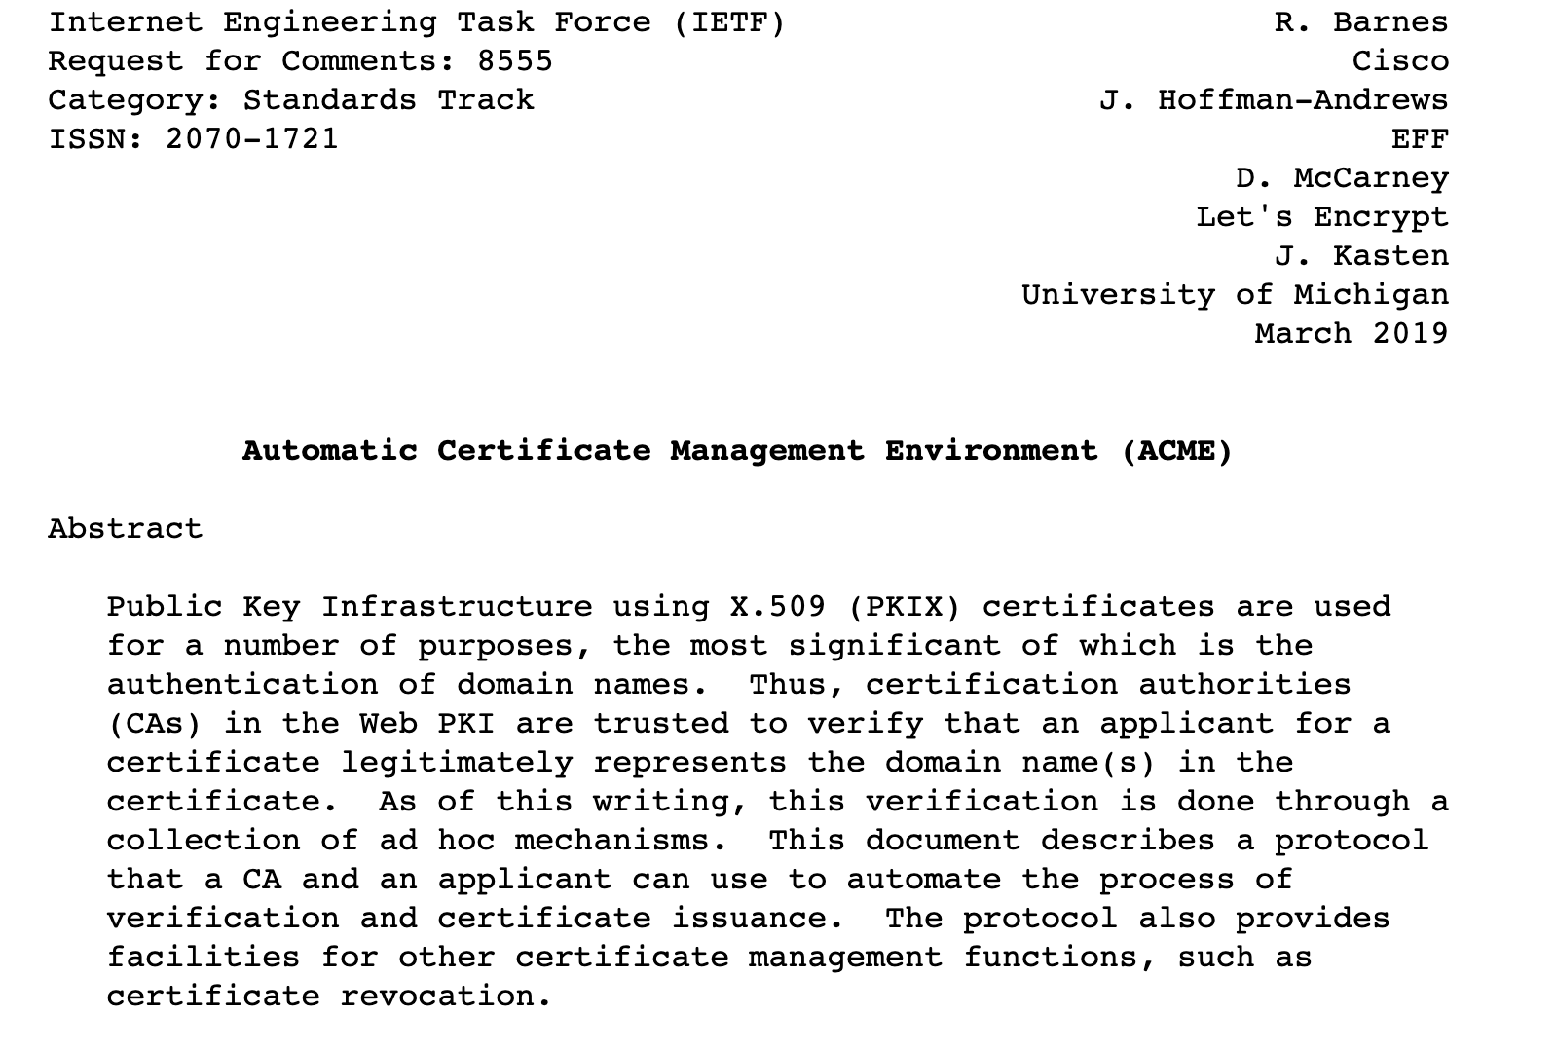
ACME

Slide 17
Authentication with Client Certificates for humans
Is rarely used
Client needs a certificate
Hard to prove who you are to the CA
Implies costly
Some countries have implemented this nationally (e.g. Denmark)

Slide 18
More common authentication
Server-side TLS
Every server is proven
HTTP level authentication
Basic Auth
Digest
OAuth2 / OpenID Connect (OIDC)

Slide 19
HTTP Authentication
Basic Auth
Easy, fast, effective
Completely insecure except over HTTPS – base64 encoding
Digest
Hash of the password
More on OAuth later

Slide 20
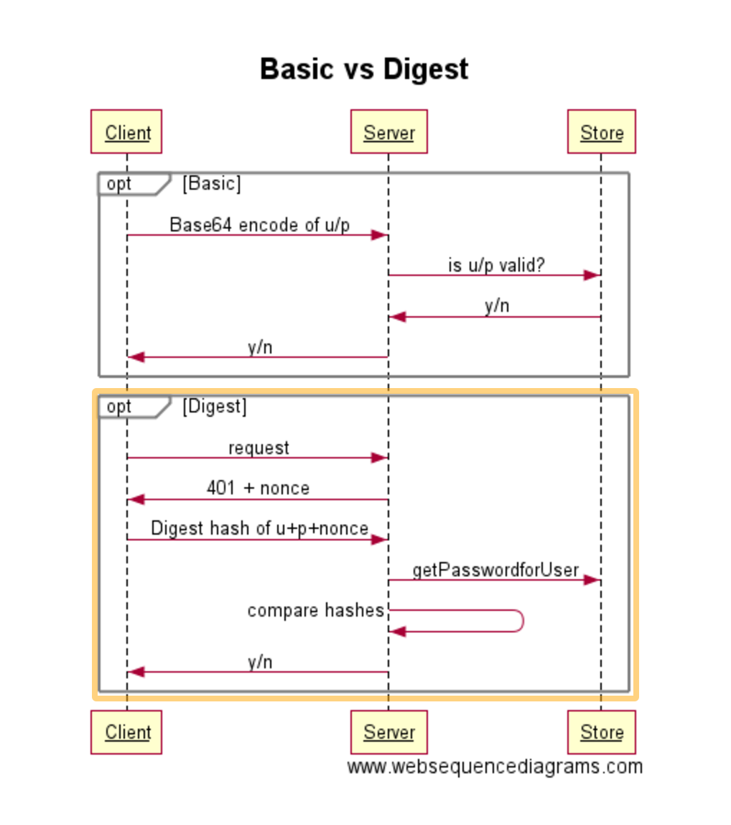
Basic vs Digest

Slide 21
Integrity
Include a signed hash in with the message
Only the sender could do this
If the message is modified or manipulated the receiver will calculate a different hash to the sender
This is used for both integrity AND authenticity
The signed hash is equivalent to signing the message

Slide 22
Non-repudiation
This is done by passing back a signed hash of the signed hash!
The receiver can prove that the sender sent the message (log the signed hash)
The receiver then signs this and sends it back
The sender logs this to prove that the receiver received the message

Slide 23

Availability

Slide 24
Performance
Public Key Cryptography is based on mathematics of very large prime numbers
The aim is that to break it will take many many years
Though Quantum Computing will change that
It is slow
Usually PKC is only used for exchange of a secret key that is then used for a session

Slide 25
The problem with passwords
cabbage Sorry the password must be more than 8 chars boiled cabbage
Sorry, you must have a numerical character
1 boiled cabbage
Sorry, no blank spaces
50frickingboiledcabbages Sorry, at least one upper case 50FRICKINGboiledcabbages Sorry, the password cannot have more than one upper case consecutively 50FrickingBoiledCabbagesShovedSomewhereIfYouDon’tGiveMeAccess Sorry, no punctuation

Slide 26
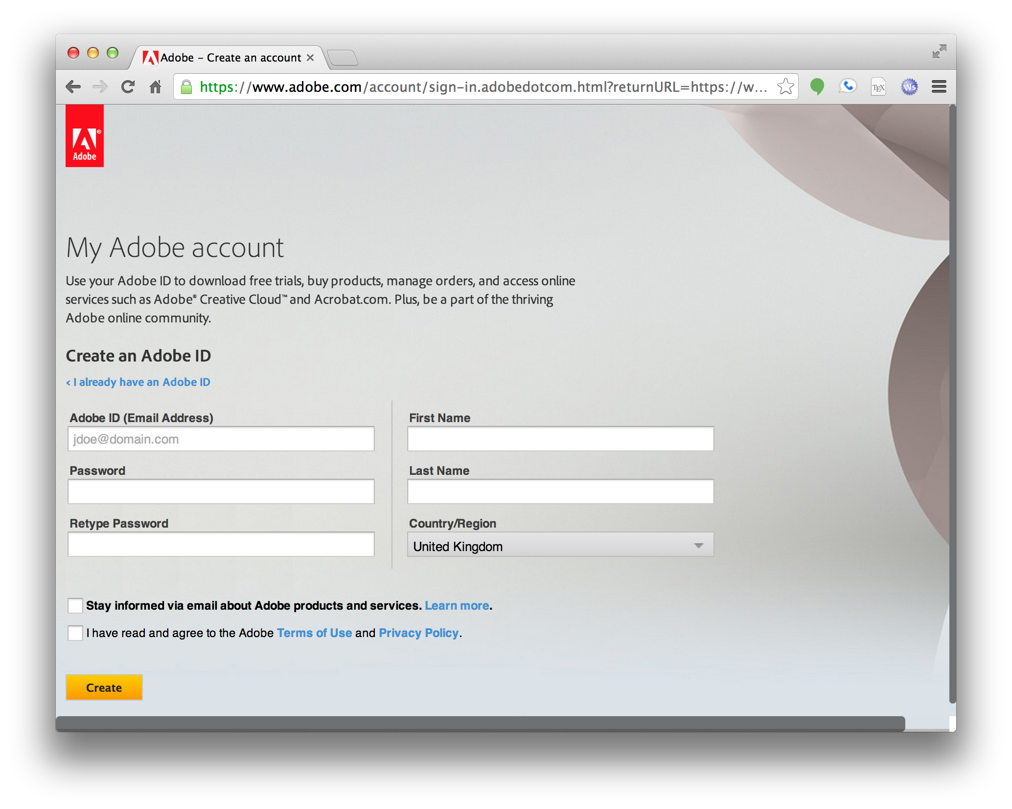

Slide 27
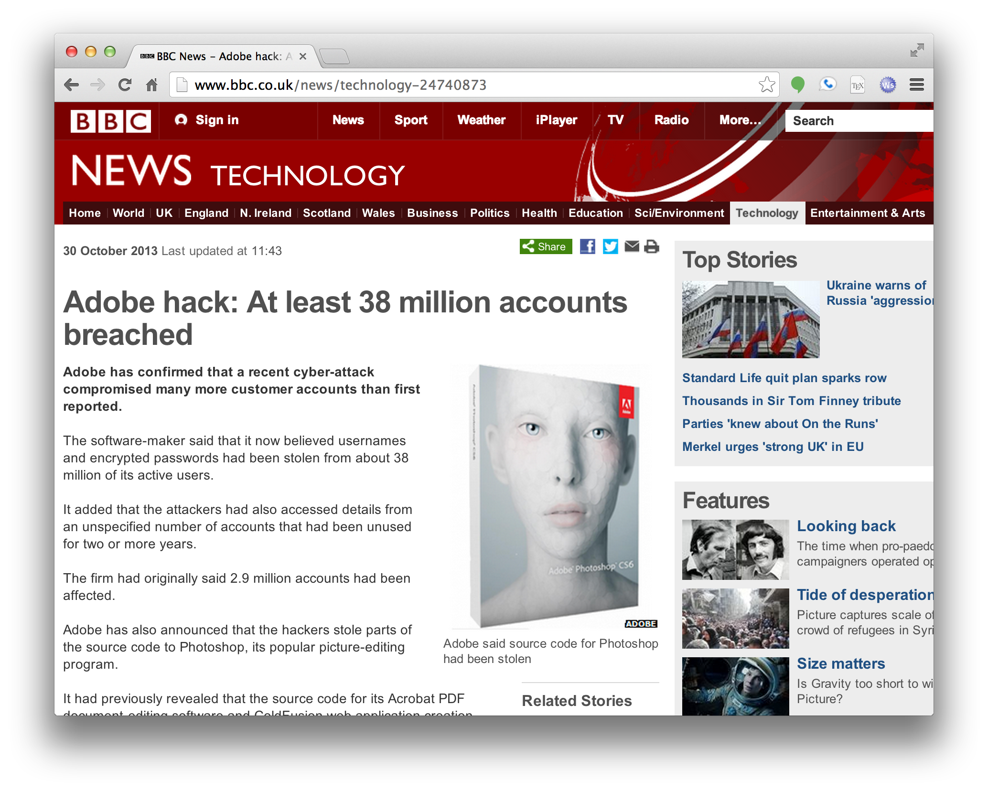

Slide 28
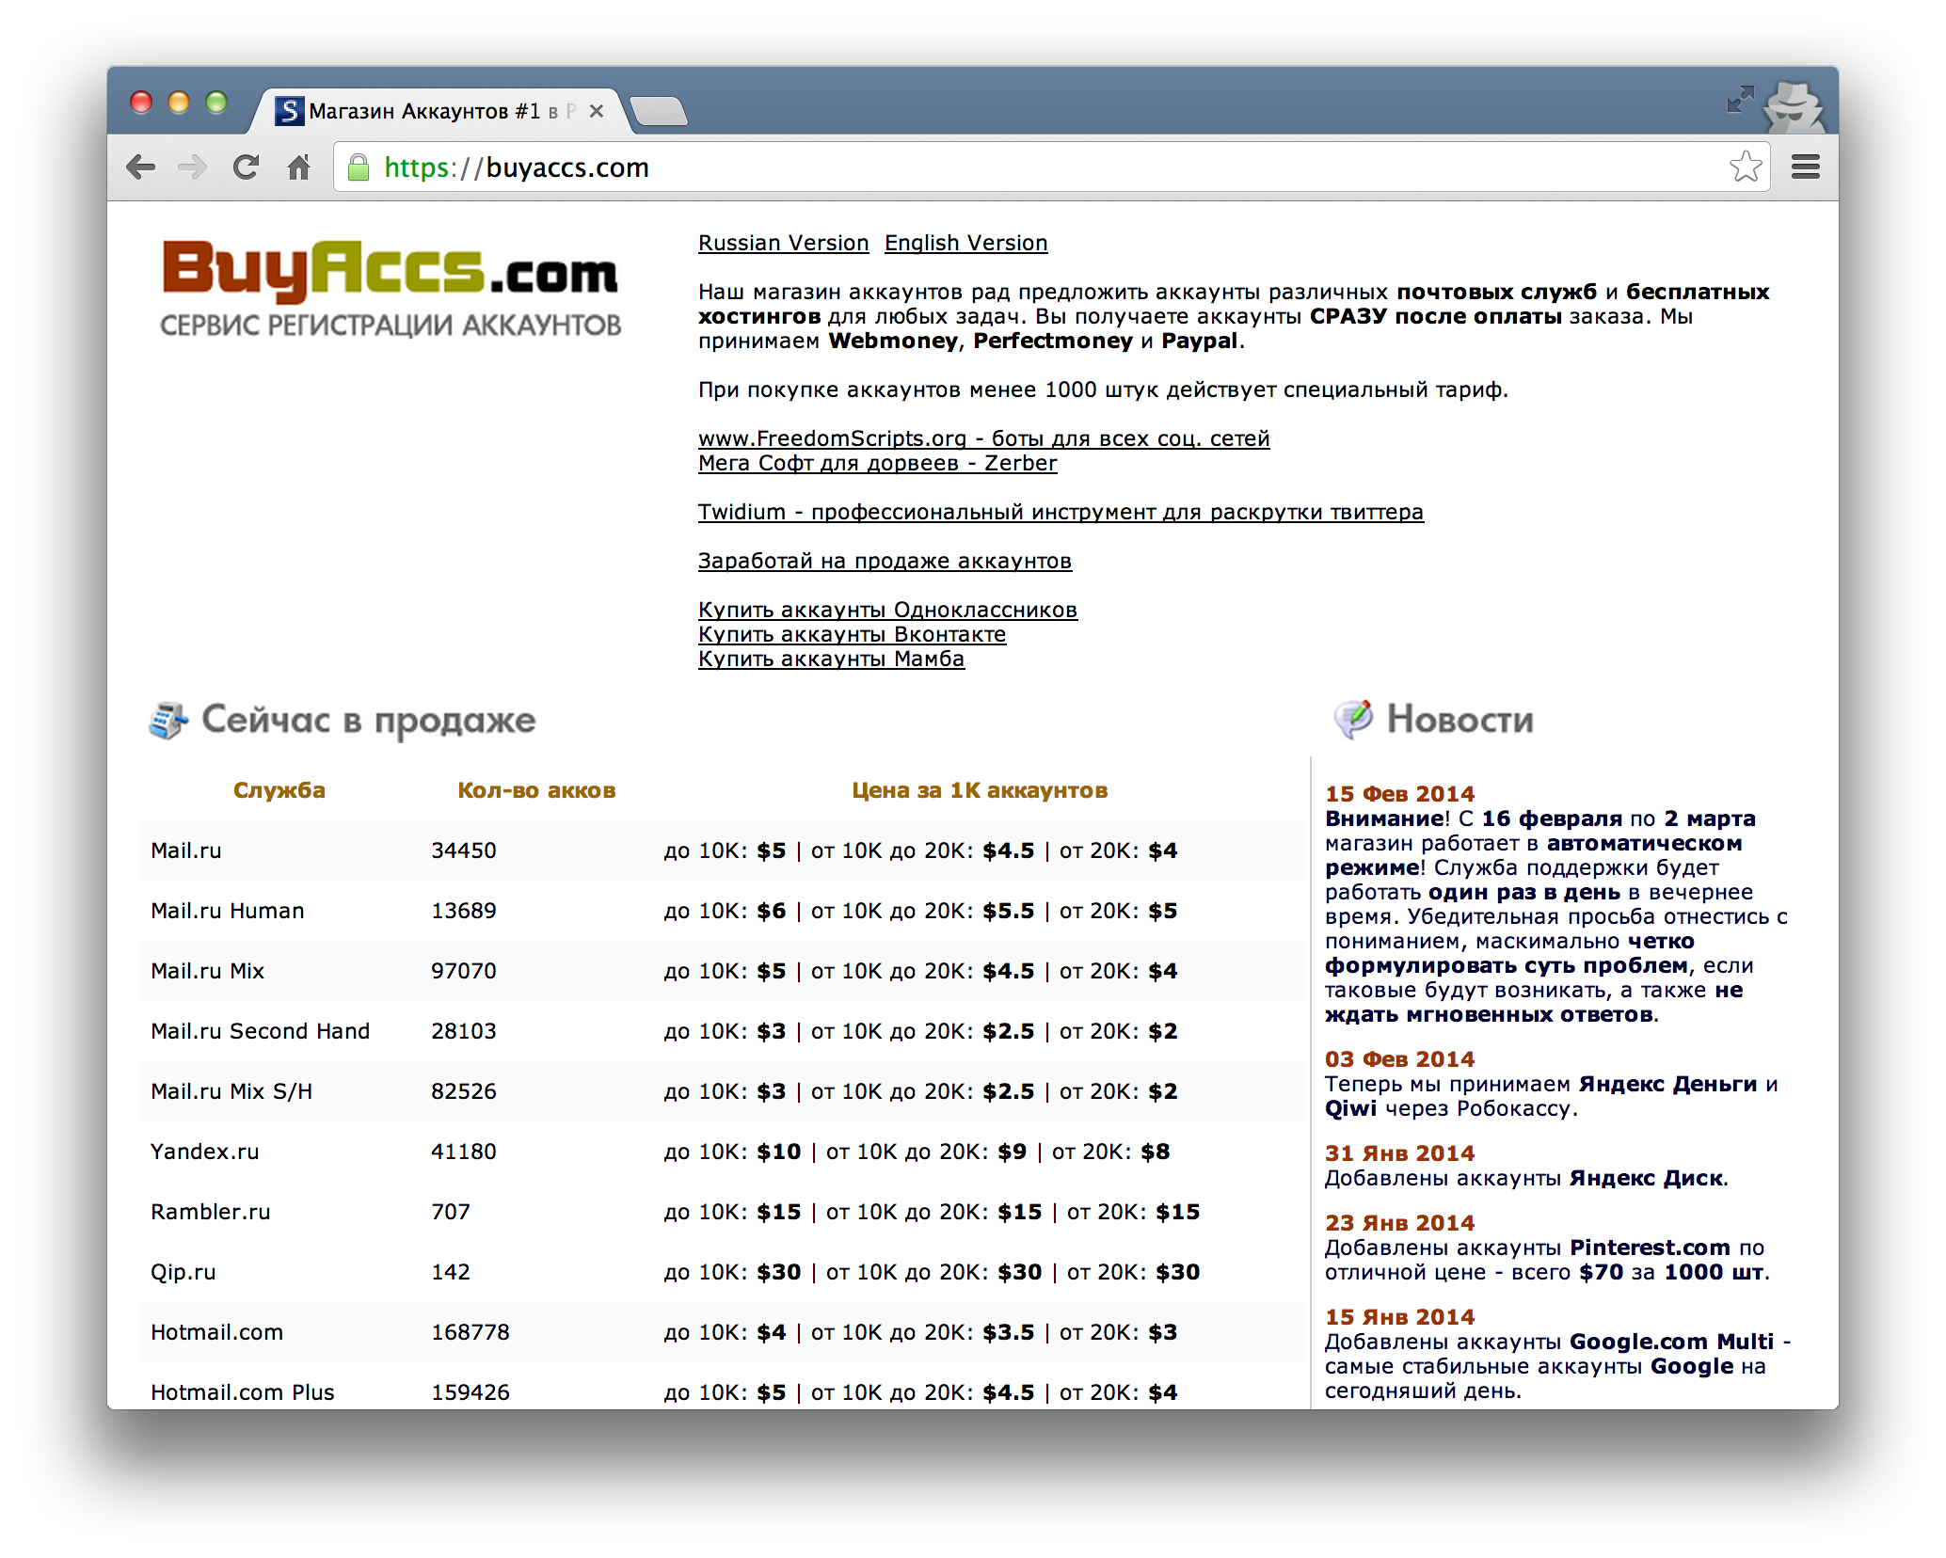

Slide 29
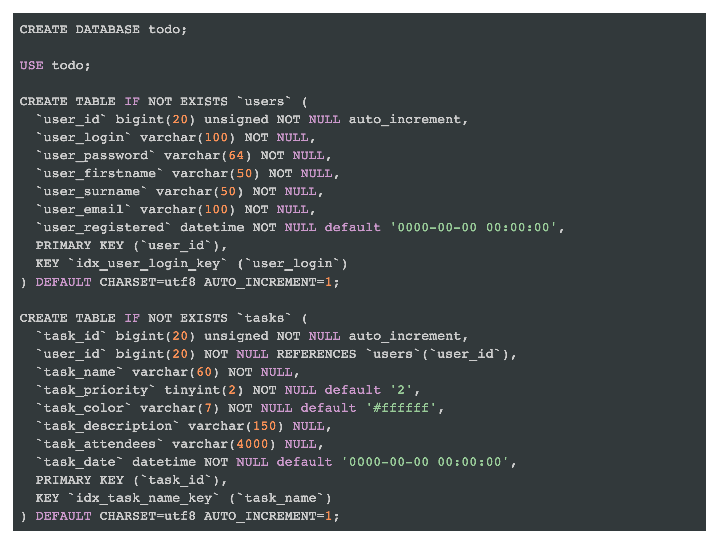
Third hit on Google “how to add authentication php”
http://www.developerdrive.com/2013/05/creating-a-simple-to-do-application-%E2%80%93-part-3

Slide 30
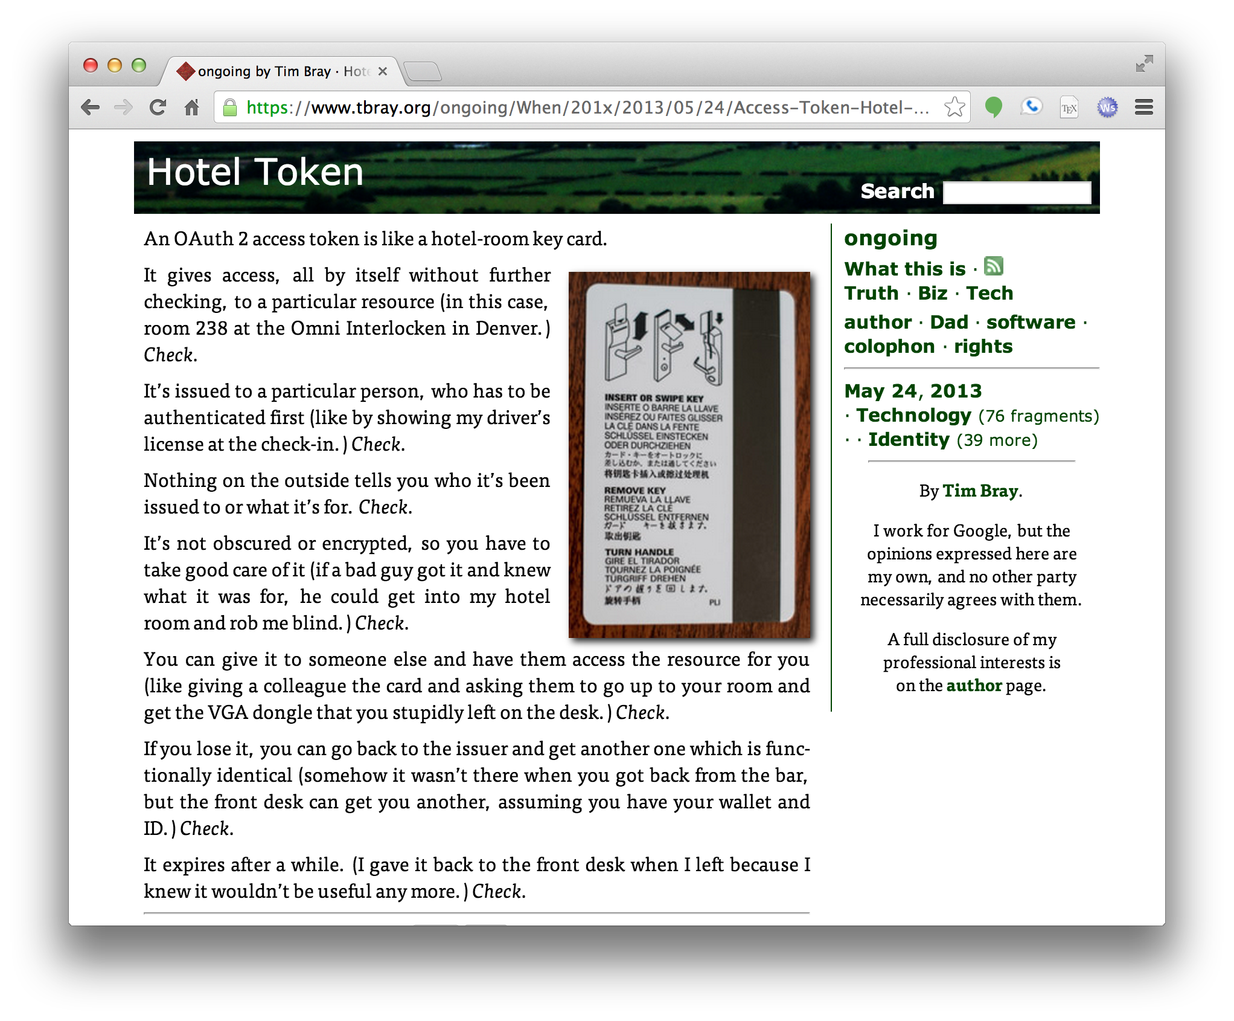

Slide 31
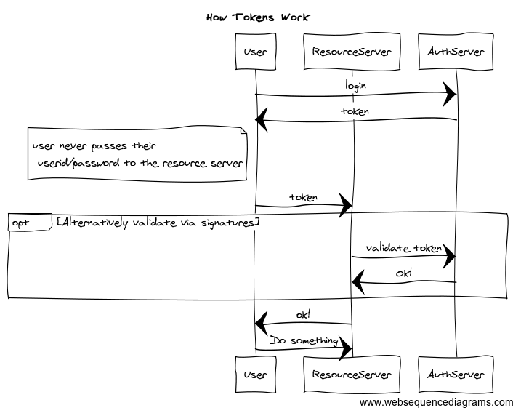
Tokens
Notes:
title How Tokens Work
participant User
participant ResourceServer
User->AuthServer: login
AuthServer->User: token
note left of User: user never passes their\n userid/password to the resource server
User->ResourceServer: token
opt Alternatively validate via signatures
ResourceServer->AuthServer: validate token
AuthServer->ResourceServer: Ok!
end
ResourceServer->User: ok!
User->ResourceServer: Do something

Slide 32
Tokens
Kerberos Tickets
Developed by MIT in the late 80’s onwards
Designed to allow lots of campus machines to be secured easily (without having local UNIX password files!)
Based on Needham-Schroder
SAML/SAML2
An XML version that has become a popular way of doing Single Sign On for the Web
Used by Google Apps/Shibboleth/etc

Slide 33
LinkedIn example
LinkedIn used to ask for your Gmail userid and password
They said they would only use this to get your contact list for certain purposes and would delete afterwards
What do you think?

Slide 34
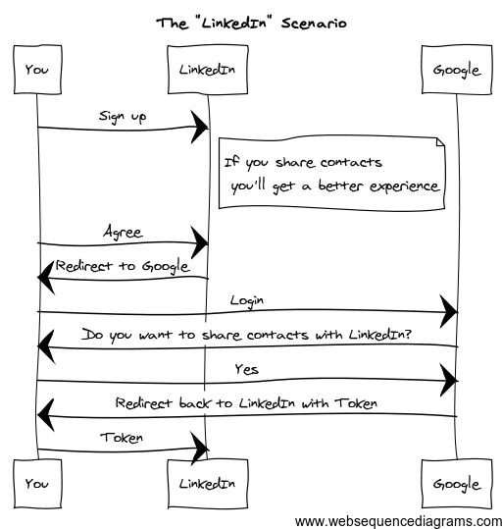
Notes:
title The "LinkedIn" Scenario
You->LinkedIn: Sign up
note right of LinkedIn: If you share contacts\n you'll get a better experience
You->LinkedIn: Agree
LinkedIn->You: Redirect to Google
You->Google: Login
Google->You: Do you want to share contacts with LinkedIn?
You->Google: Yes
Google->You: Redirect back to LinkedIn with Token
You->LinkedIn: Token

Slide 35
OAuth Terminology
Resource Owner
The end user or logical owner of the resource
The gmail user
Resource Server
The server that contains or controls access to the resource
The contact list
Client
The system looking for access to the resource
LinkedIn
Authorization Server
The system that maintains the user identity and issuing tokens
Google identity

Slide 36
The more detailed version!

Slide 37
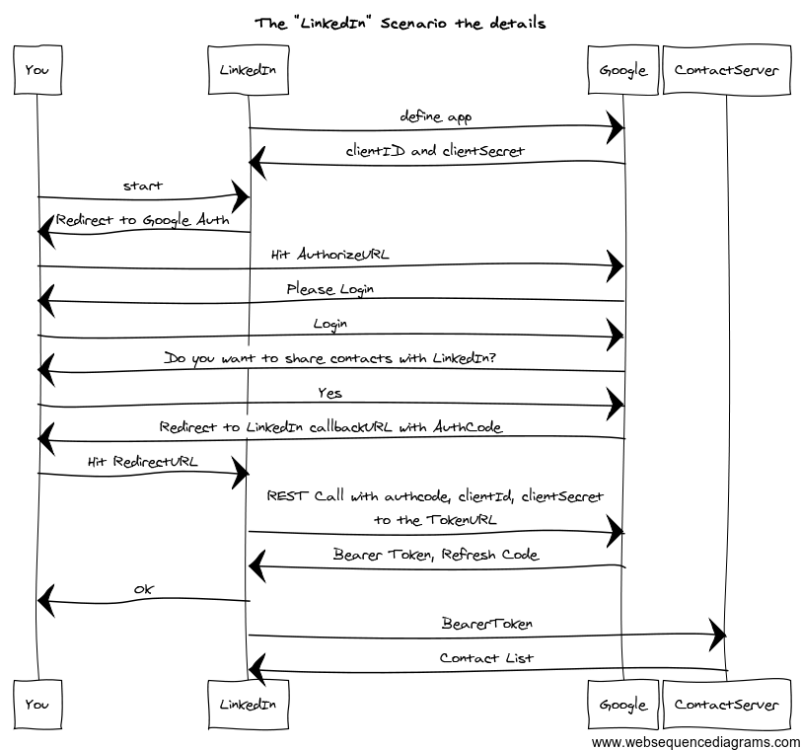
Notes:
title The "LinkedIn" Scenario the details
participant You
participant LinkedIn
participant Google
LinkedIn->Google: define app
Google->LinkedIn: clientID and clientSecret
You->LinkedIn: start
LinkedIn->You: Redirect to Google Auth
You->Google: Hit AuthorizeURL
Google->You: Please Login
You->Google: Login
Google->You: Do you want to share contacts with LinkedIn?
You->Google: Yes
Google->You: Redirect to LinkedIn callbackURL with AuthCode
You->LinkedIn: Hit RedirectURL
LinkedIn->Google: REST Call with authcode, clientId, clientSecret\nto the TokenURL
Google->LinkedIn: Bearer Token, Refresh Code
LinkedIn->You: Ok
LinkedIn->ContactServer: BearerToken
ContactServer->LinkedIn: Contact List

Slide 38
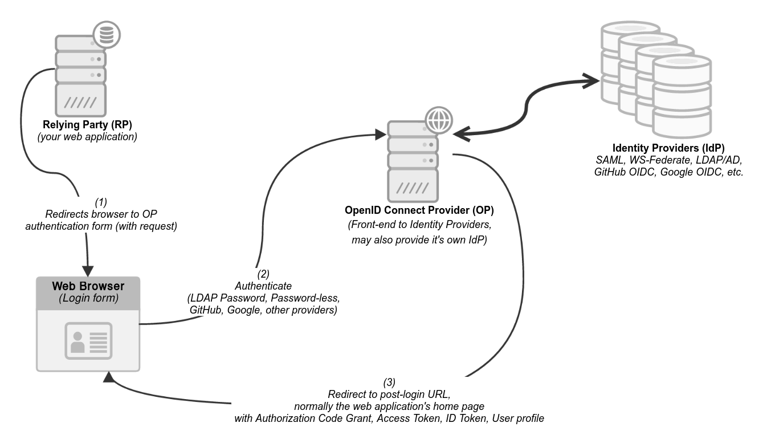
OpenID Connect (OIDC)

Slide 39
Open Source OIDC systems
Keycloak
Fully featured OIDC/OAuth2/SAML server from Redhat
WSO2 Identity Server
OAuth2/OIDC/SAML IdP and broker
dex
A Kubernetes OIDC provider that only does federated login

Slide 40
Criticisms of OAuth2
http://hueniverse.com/2012/07/oauth-2-0-and-the-road-to-hell/
“When compared with OAuth 1.0, the 2.0 specification is more complex, less interoperable, less useful, more incomplete, and most importantly, less secure.”
Main concern:
Bearer tokens+TLS vs client signature

Slide 41
A retrospective reasoning for OAuth
Two significant factors:
Billions of users do not fit well into traditional hierarchical models
Graph-based, user directed approaches work better – Facebook Friends, Google Circles
The Web and REST architecture inherently promotes linked websites, ecosystems, federation
At the same time the web protocols make this easier to do in a standard, interoperable way

Slide 42
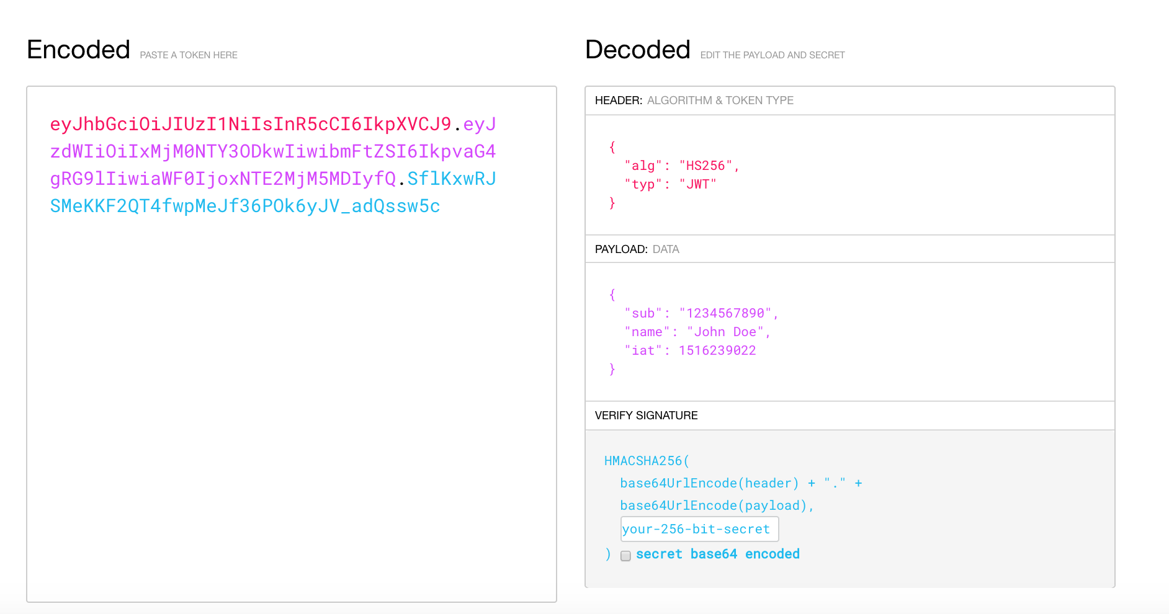
JSON Web Tokens

Slide 43
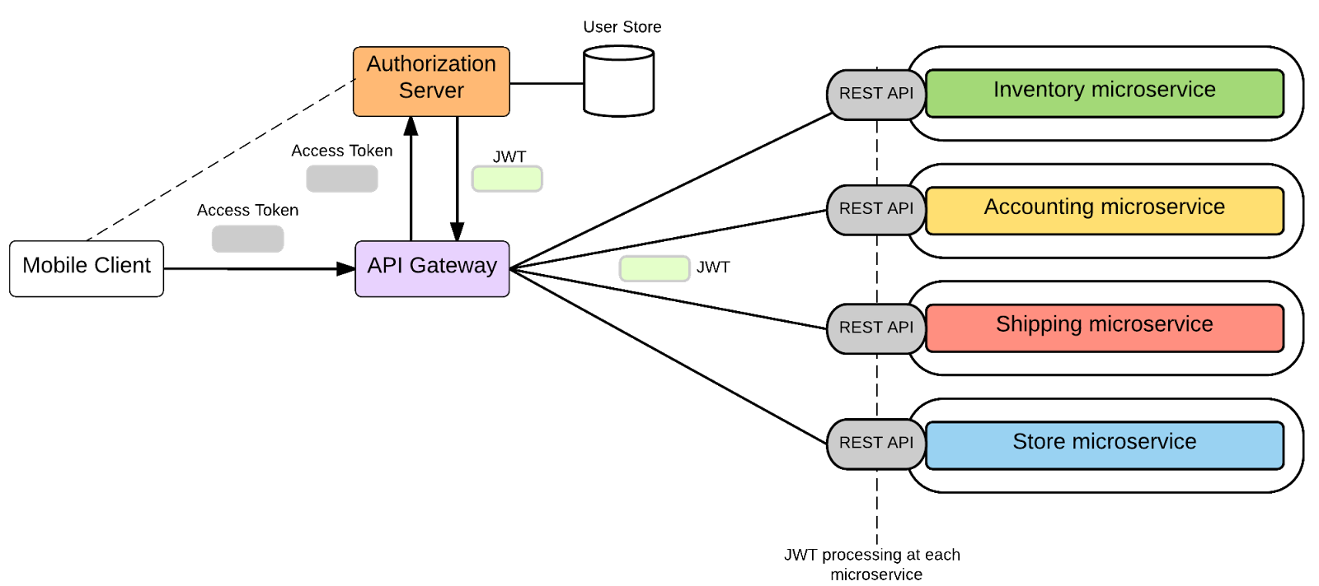
JWT in Microservices

Slide 44
mTLS
mutual TLS is where both sides have a certificate
Has come back into fashion for microservices
Built in support from Service Meshes

Slide 45
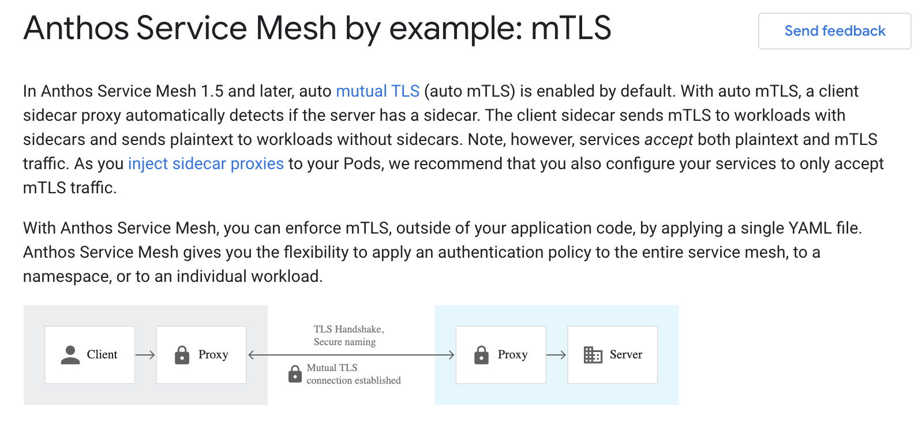
mTLS - mutual TLS by Proxy

Slide 46
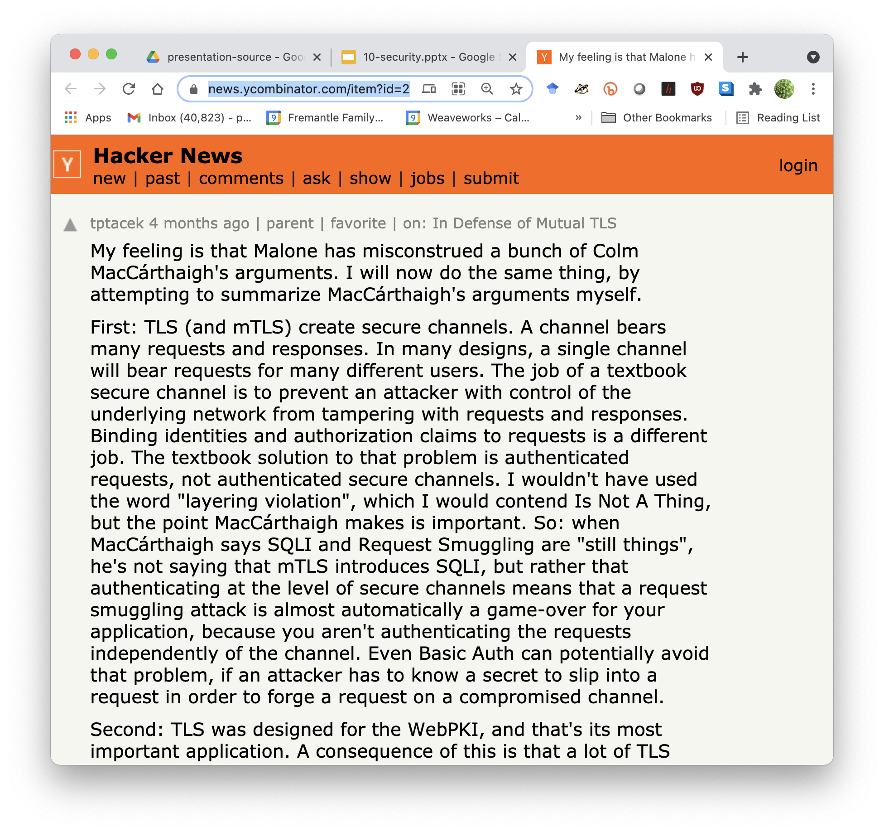
An interesting thread on mTLS
https://news.ycombinator.com/item?id=25380301

Slide 47
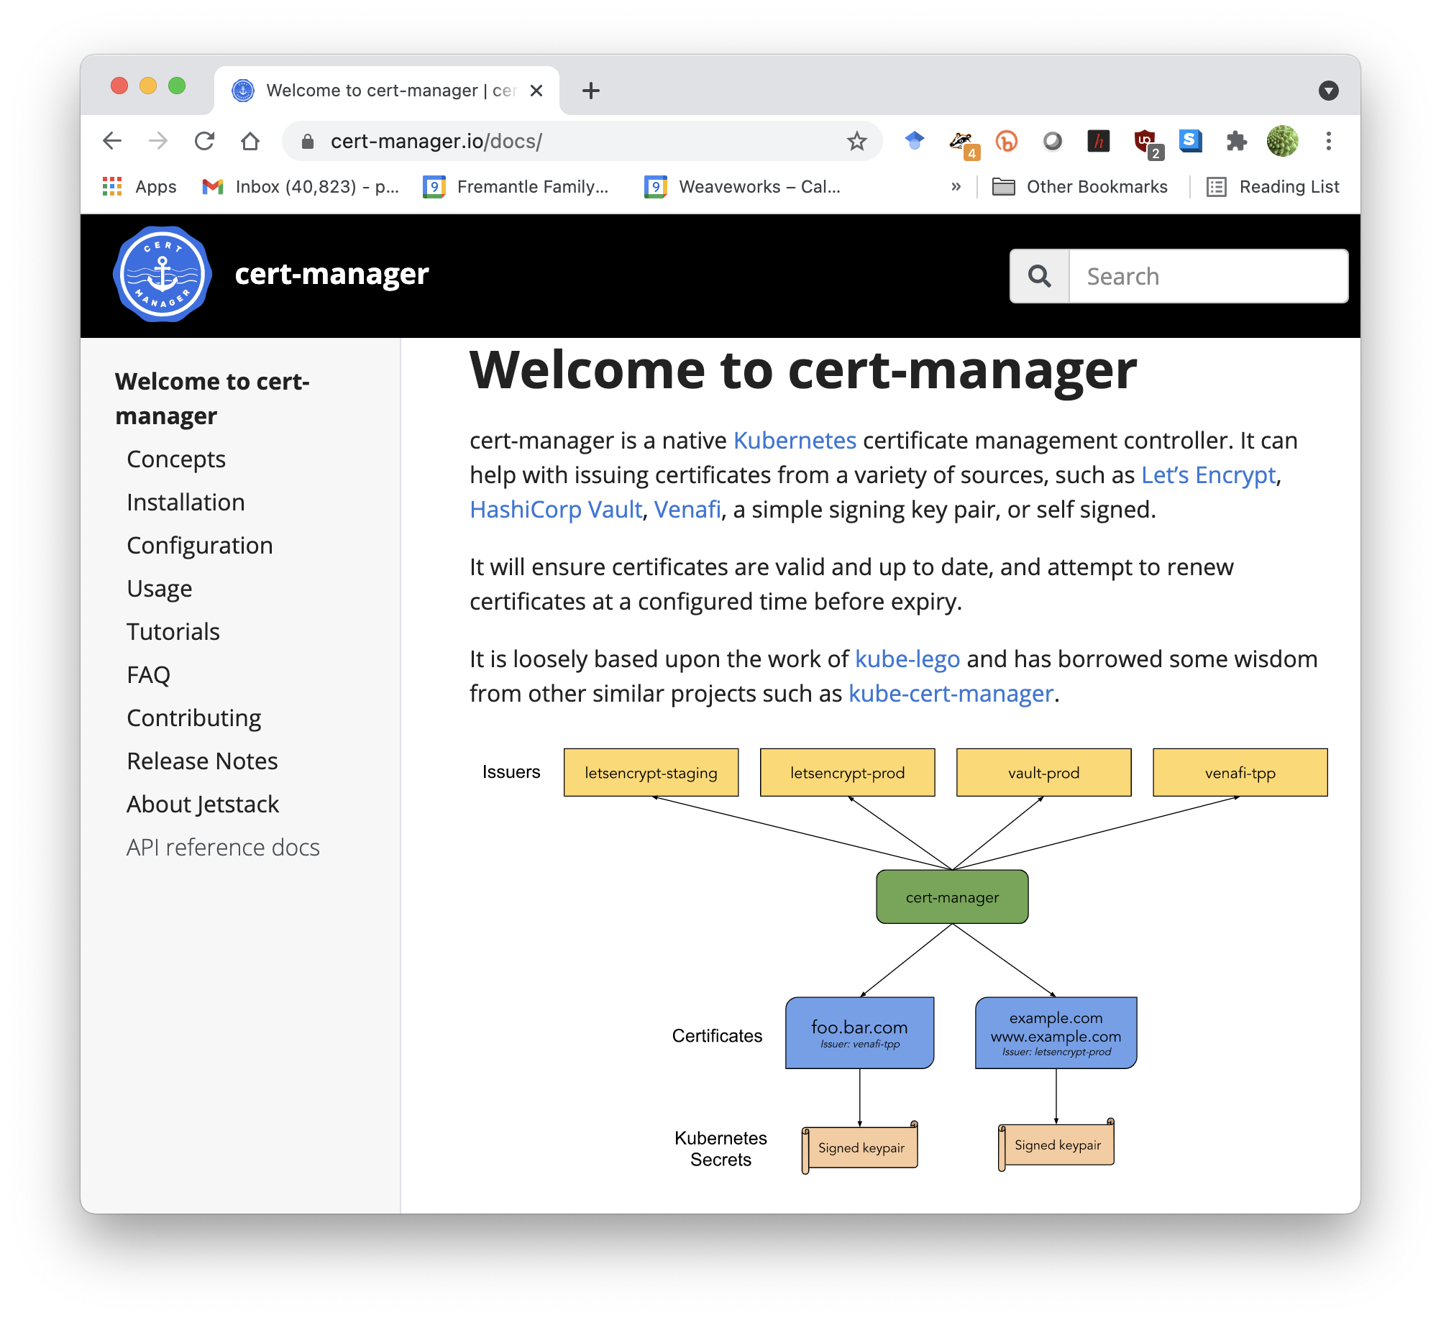

Slide 48
Access Control
Traditionally Authorization has been
Role-based
If I am a manager then I can look at salaries
Based only on user
Hard-coded
Authorization rules encapsulated in code and applications

Slide 49
Problems with RBAC
Problems with this are:
Doesn’t correctly model the real world
I should only be able to see my team’s salaries, and only while participating in the salary review process
Hard to evolve
Hard to manage compliance
How do I find out who can make a trade of $30m?

Slide 50
Policy Based Access Control
Delegate access control decisions to a “Policy Decision Point”
Utilise more information in the decision
Externalise the decision from the code

Slide 51
XACML 3.0
An XML language for capturing authorization and entitlement
Together with a powerful model
Terminology
Policy Decision Point (PDP)
Policy Enforcement Point (PEP)
Policy Administration Point (PAP)
Policy Information Point (PIP)

Slide 52
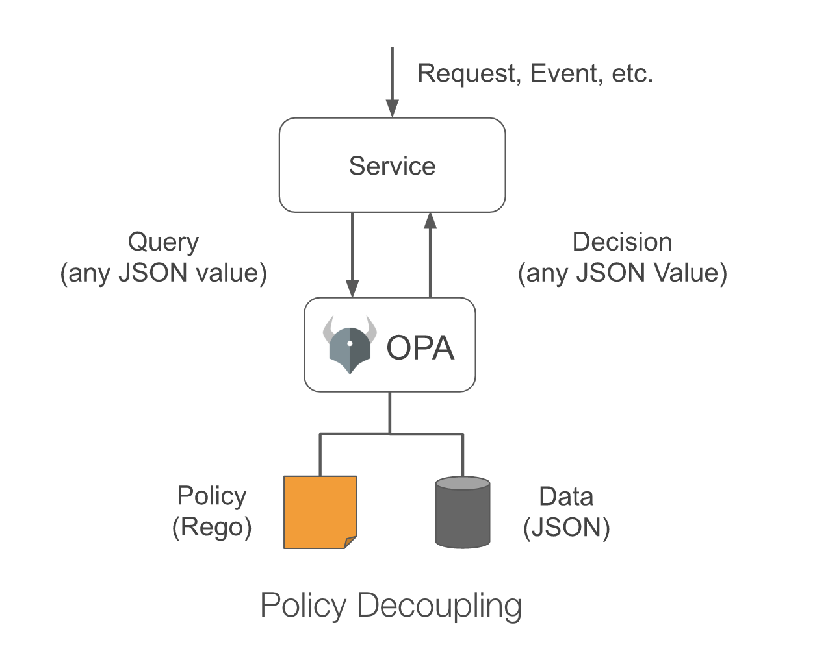
Open Policy Agent (OPA)

Slide 53
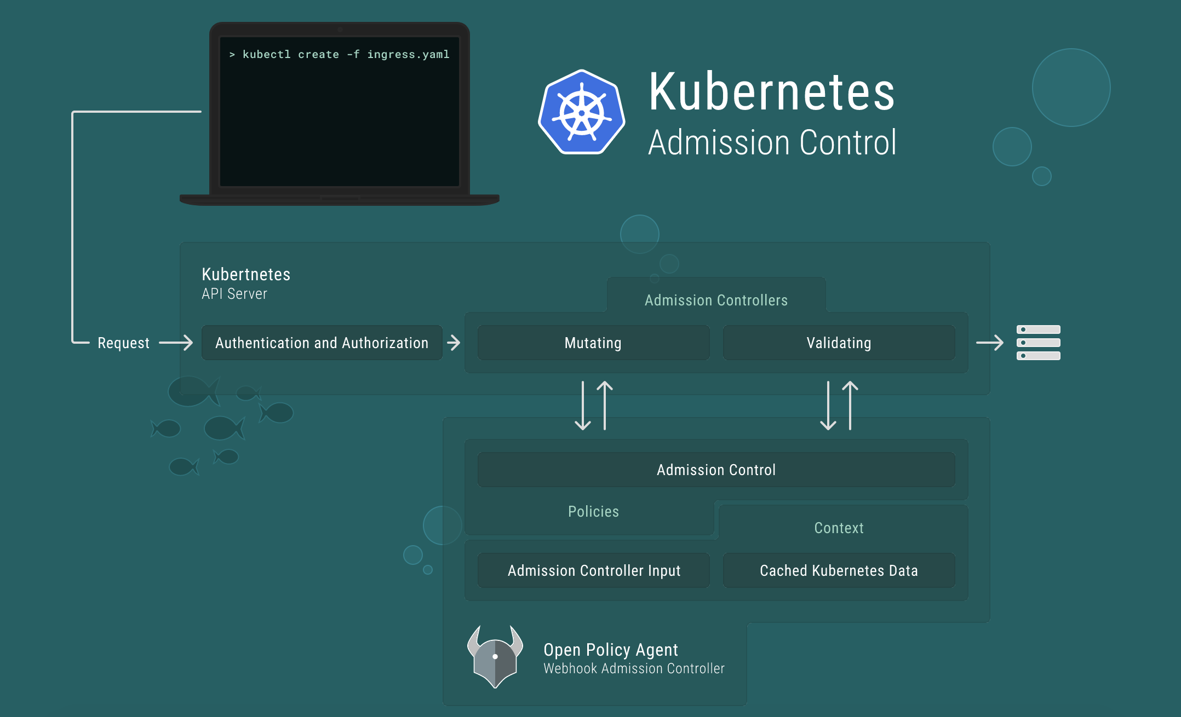
OPA in Kubernetes

Slide 54
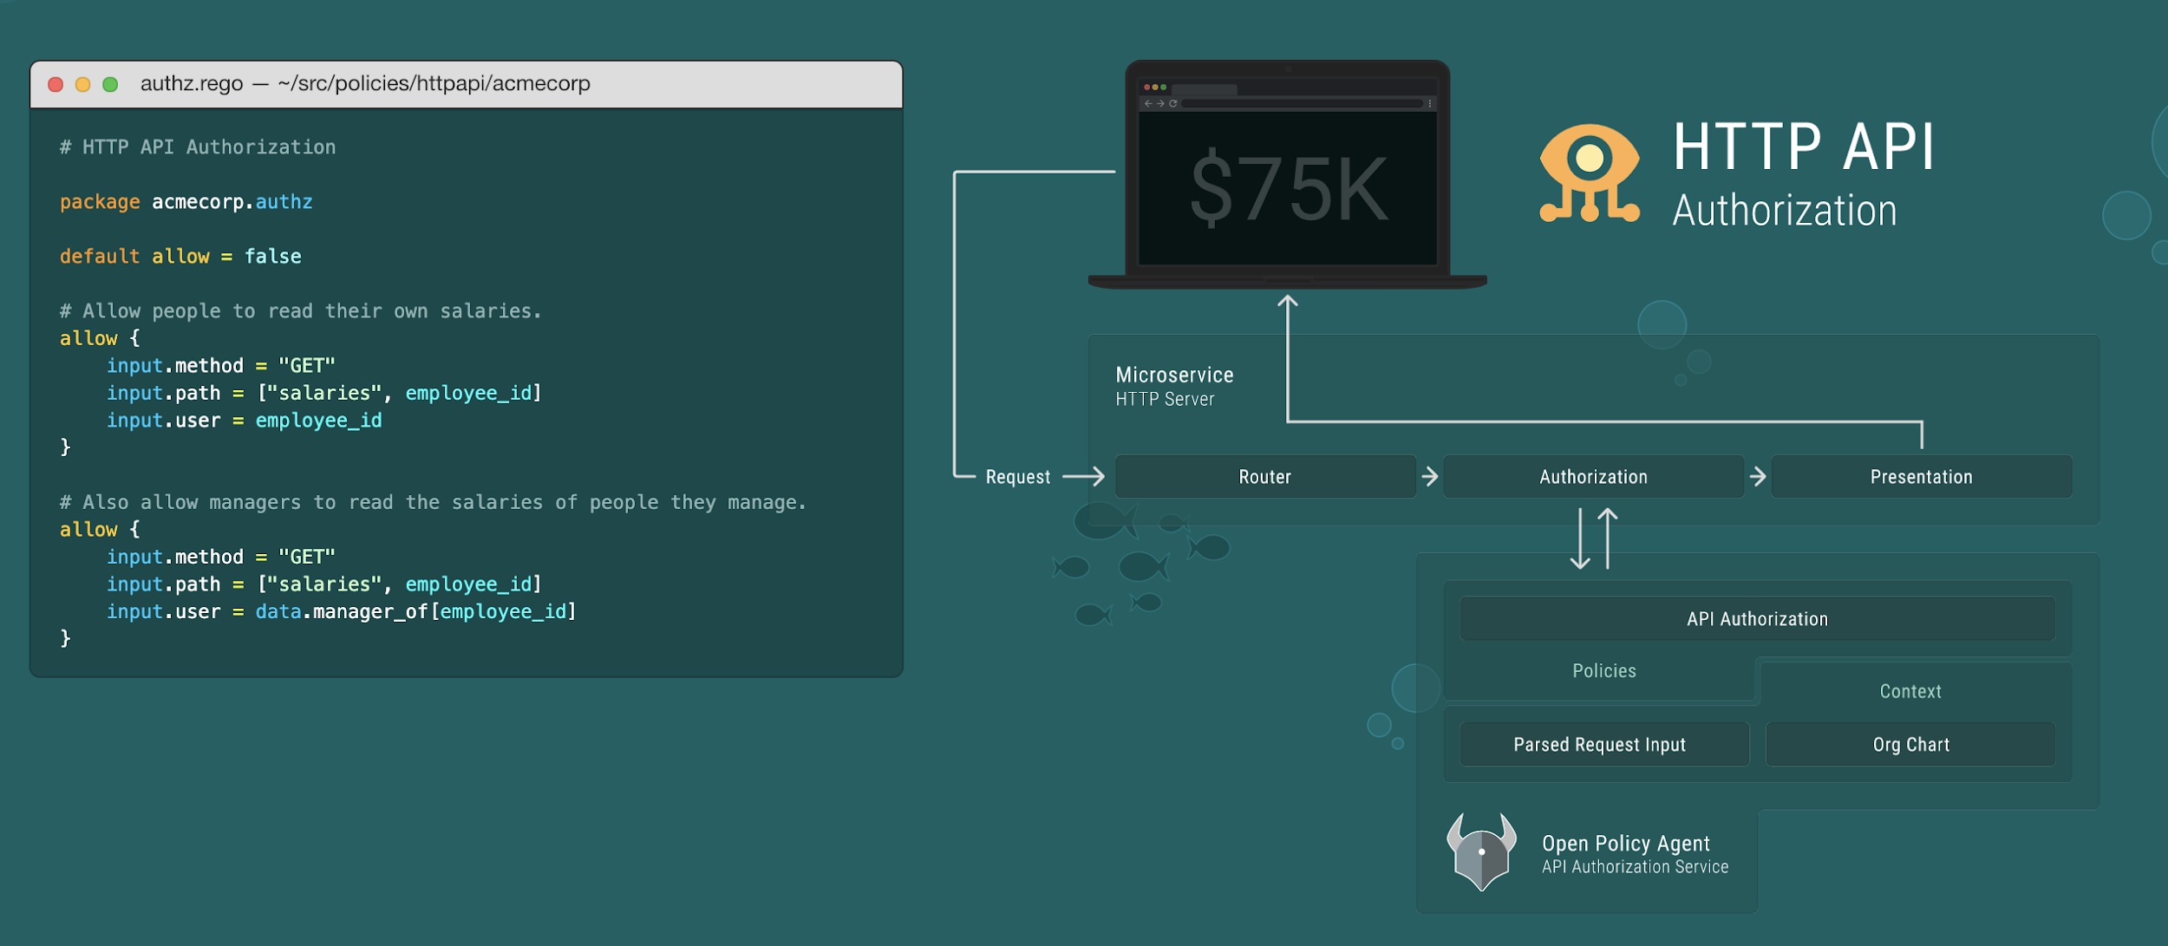
OPA for HTTP APIs

Slide 55
Resources
Applied Cryptography, Second Edition, Bruce Schneier, John Wiley & Sons, 1996, ISBN 0-471-11709-9
Web Services Security, Mark O’Neill, 2003, ISBN 0072224711
Google (sorry but there are too many links!)

